Slide 1
Classification: Advanced Methods
Data Mining: Concepts and Techniques
Jiawei Han, Micheline Kamber, and Jian Pei
Introduction to Data Mining, 2nd Edition
Tan, Steinbach, Karpatne, Kumar

Slide 2
Chapter 9. Classification: Advanced Methods
Bayesian Belief Networks
Classification by Backpropagation
Support Vector Machines
Classification by Using Frequent Patterns
Lazy Learners (or Learning from Your Neighbors)
Other Classification Methods
Additional Topics Regarding Classification
Summary

Slide 3
Bayesian Belief Networks
Bayesian belief networks (also known as Bayesian networks, probabilistic networks): allow class conditional independencies between subsets of variables
A (directed acyclic) graphical model of causal relationships
  Represents dependency among the variables
  Gives a specification of joint probability distribution
Nodes: random variables
Links: dependency
X and Y are the parents of Z, and Y is the parent of P
No dependency between Z and P
Has no loops/cycles
X
Y
Z
P

Slide 4
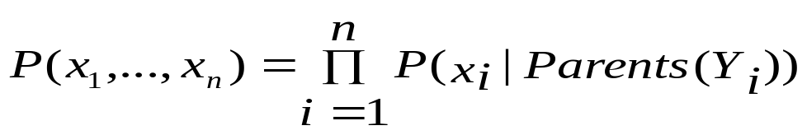
Bayesian Belief Network: An Example
Family
History (FH)
Smoker (S)
CPT: Conditional Probability Table for variable LungCancer:
(FH, S)
(FH, ~S)
(~FH, S)
(~FH, ~S)
LC
0.8
0.5
0.7
0.1
LungCancer
(LC)
Emphysema
~LC
0.2
0.5
0.3
0.9
shows the conditional probability for each possible combination of its parents
PositiveXRay
Dyspnea
Derivation of the probability of a particular combination of values of X, from CPT:
Bayesian Belief Network

Slide 5
Training Bayesian Networks: Several Scenarios
Scenario 1: Given both the network structure and all variables observable: compute only the CPT entries
Scenario 2: Network structure known, some variables hidden: gradient descent (greedy hill-climbing) method, i.e., search for a solution along the steepest descent of a criterion function
  Weights are initialized to random probability values
  At each iteration, it moves towards what appears to be the best solution at the moment, w.o. backtracking
  Weights are updated at each iteration & converge to local optimum
Scenario 3: Network structure unknown, all variables observable: search through the model space to reconstruct network topology
Scenario 4: Unknown structure, all hidden variables: No good algorithms known for this purpose
D. Heckerman. A Tutorial on Learning with Bayesian Networks. In Learning in Graphical Models, M. Jordan, ed.. MIT Press, 1999.

Slide 6
Chapter 9. Classification: Advanced Methods
Bayesian Belief Networks
Classification by Backpropagation
Support Vector Machines
Classification by Using Frequent Patterns
Lazy Learners (or Learning from Your Neighbors)
Other Classification Methods
Additional Topics Regarding Classification
Summary

Slide 7
Classification by Backpropagation
Backpropagation: A neural network learning algorithm
Started by psychologists and neurobiologists to develop and test computational analogues of neurons
A neural network: A set of connected input/output units where each connection has a weight associated with it
During the learning phase, the network learns by adjusting the weights so as to be able to predict the correct class label of the input tuples
Also referred to as connectionist learning due to the connections between units

Slide 8
Neural Network as a Classifier
Weakness
  Long training time
  Require a number of parameters typically best determined empirically, e.g., the network topology or “structure.”
  Poor interpretability: Difficult to interpret the symbolic meaning behind the learned weights and of “hidden units” in the network
Strength
  High tolerance to noisy data
  Ability to classify untrained patterns
  Well-suited for continuous-valued inputs and outputs
  Successful on an array of real-world data, e.g., hand-written letters
  Algorithms are inherently parallel
  Techniques have recently been developed for the extraction of rules from trained neural networks

Slide 9
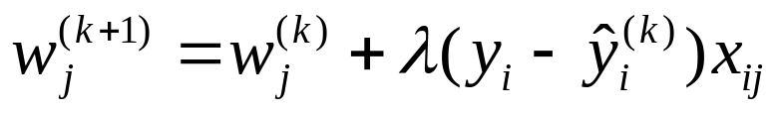
A Multi-Layer Feed-Forward Neural Network
Output vector
Output layer
Hidden layer
w_{ij}
Input layer
Input vector: X
Notes:
MK: Note – different notation than used in book. Will have to standardize notation.

Slide 10
How A Multi-Layer Neural Network Works
The inputs to the network correspond to the attributes measured for each training tuple
Inputs are fed simultaneously into the units making up the input layer
They are then weighted and fed simultaneously to a hidden layer
The number of hidden layers is arbitrary, although usually only one
The weighted outputs of the last hidden layer are input to units making up the output layer, which emits the network's prediction
The network is feed-forward: None of the weights cycles back to an input unit or to an output unit of a previous layer
From a statistical point of view, networks perform nonlinear regression: Given enough hidden units and enough training samples, they can closely approximate any function

Slide 11
Defining a Network Topology
Decide the network topology: Specify # of units in the input layer, # of hidden layers (if > 1), # of units in each hidden layer, and # of units in the output layer
Normalize the input values for each attribute measured in the training tuples to [0.0—1.0]
One input unit per domain value, each initialized to 0
Output, if for classification and more than two classes, one output unit per class is used
Once a network has been trained and its accuracy is unacceptable, repeat the training process with a different network topology or a different set of initial weights

Slide 12
Backpropagation
Iteratively process a set of training tuples & compare the network's prediction with the actual known target value
For each training tuple, the weights are modified to minimize the mean squared error between the network's prediction and the actual target value
Modifications are made in the “backwards” direction: from the output layer, through each hidden layer down to the first hidden layer, hence “backpropagation”
Steps
  Initialize weights to small random numbers, associated with biases
  Propagate the inputs forward (by applying activation function)
  Backpropagate the error (by updating weights and biases)
  Terminating condition (when error is very small, etc.)

Slide 13
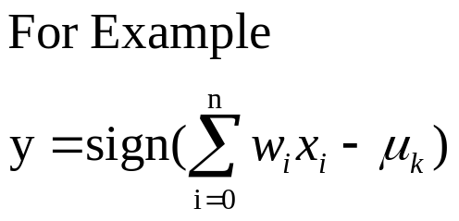
Neuron: A Hidden/Output Layer Unit
bias
μ_{k}
x₀
w₀
x₁
w₁
∑
f
output y
x_{n}
w_{n}
Input
vector x
weight
vector w
weighted
sum
Activation
function
An n-dimensional input vector x is mapped into variable y by means of the scalar product and a nonlinear function mapping
The inputs to unit are outputs from the previous layer. They are multiplied by their corresponding weights to form a weighted sum, which is added to the bias associated with unit. Then a nonlinear activation function is applied to it.

Slide 14
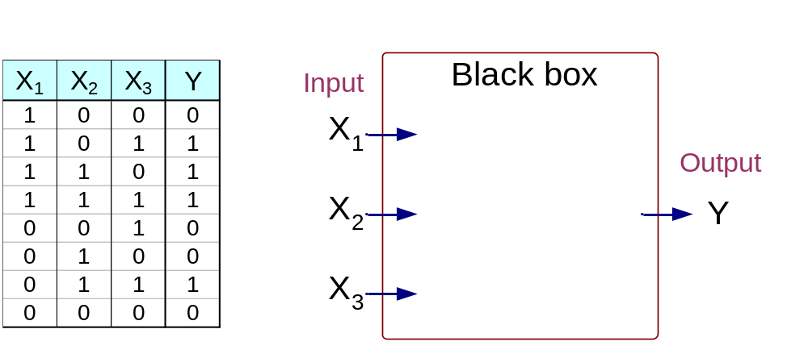
Artificial Neural Networks (ANN)
Output Y is 1 if at least two of the three inputs are equal to 1.
二〇二六年十一月八日
Data Mining: Concepts and Techniques

Slide 15
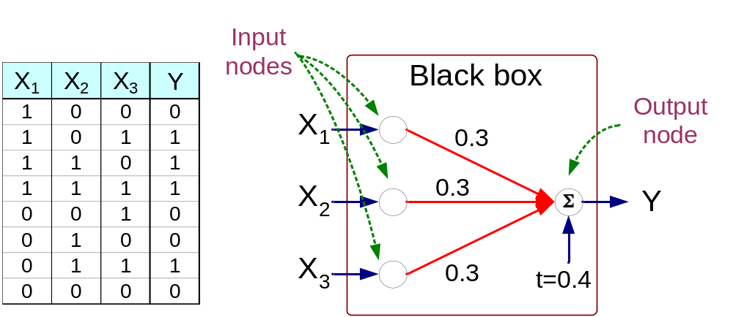
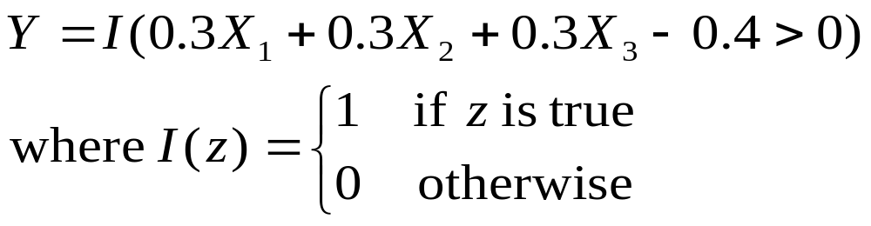
Artificial Neural Networks (ANN)
二〇二六年十一月八日
Data Mining: Concepts and Techniques

Slide 16
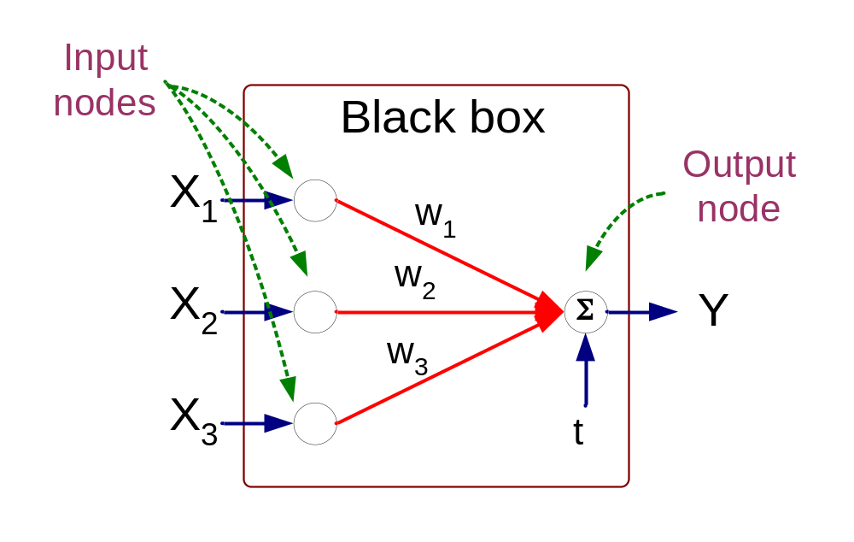
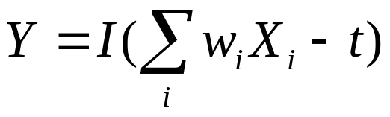
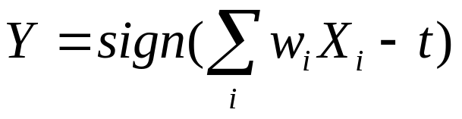
Artificial Neural Networks (ANN)
Model is an assembly of inter-connected nodes and weighted links
Output node sums up each of its input value according to the weights of its links
Compare output node against some threshold t
Perceptron Model
or
二〇二六年十一月八日
Data Mining: Concepts and Techniques

Slide 17
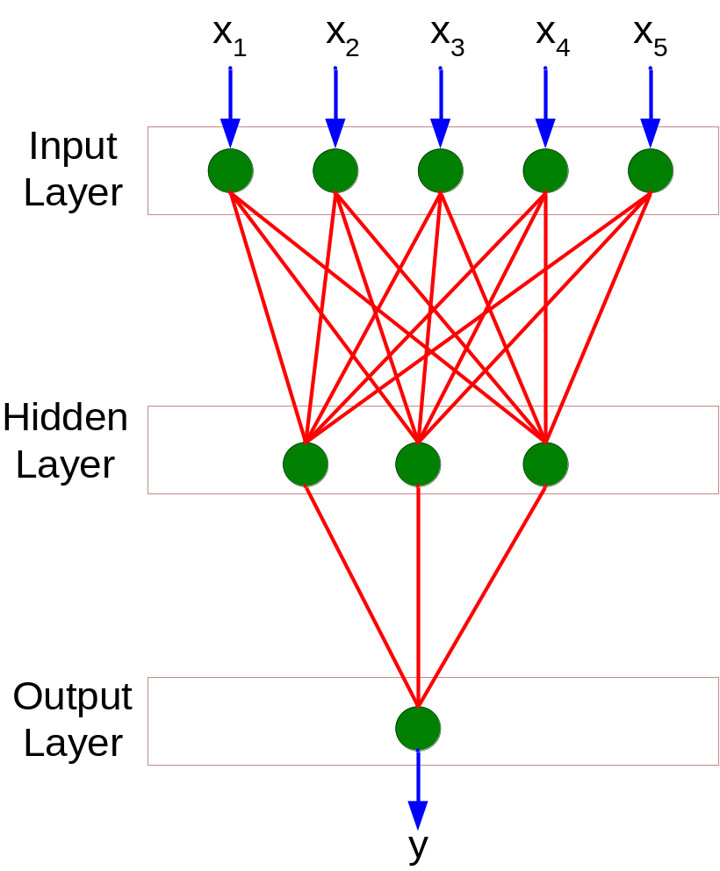
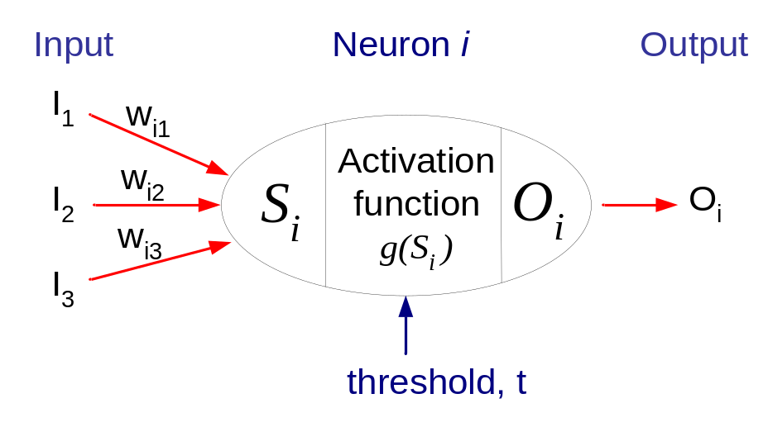
General Structure of ANN
Training ANN means learning the weights of the neurons
二〇二六年十一月八日
Data Mining: Concepts and Techniques

Slide 18




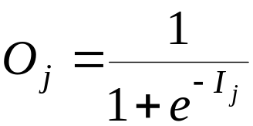
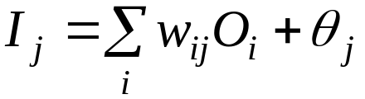
A Multi-Layer Feed-Forward Neural Network
Output vector
Output layer
Hidden layer
w_{ij}
Input layer
Input vector: X
二〇二六年十一月八日
Data Mining: Concepts and Techniques

Slide 19
Efficiency and Interpretability
Efficiency of backpropagation: Each epoch (one iteration through the training set) takes O(|D| * w), with |D| tuples and w weights, but # of epochs can be exponential to n, the number of inputs, in worst case
For easier comprehension: Rule extraction by network pruning
  Simplify the network structure by removing weighted links that have the least effect on the trained network
  Then perform link, unit, or activation value clustering
  The set of input and activation values are studied to derive rules describing the relationship between the input and hidden unit layers
Sensitivity analysis: assess the impact that a given input variable has on a network output. The knowledge gained from this analysis can be represented in rules

Slide 20
Chapter 9. Classification: Advanced Methods
Bayesian Belief Networks
Classification by Backpropagation
Support Vector Machines
Classification by Using Frequent Patterns
Lazy Learners (or Learning from Your Neighbors)
Other Classification Methods
Additional Topics Regarding Classification
Summary

Slide 21
Classification: A Mathematical Mapping
Classification: predicts categorical class labels
  E.g., Personal homepage classification
    x_{i} = (x₁, x₂, x₃, …), y_{i} = +1 or –1
    x₁ : # of word “homepage”
    x₂ : # of word “welcome”
Mathematically, x ∈ X = ℜ^{n}, y ∈ Y = {+1, –1},
  We want to derive a function f: X → Y
Linear Classification
  Binary Classification problem
  Data above the red line belongs to class ‘x’
  Data below red line belongs to class ‘o’
  Examples: SVM, Perceptron, Probabilistic Classifiers
x
x
x
x
x
x
x
x
x
o
o
x
o
o
o
o
o
o
o
o
o
o
o

Slide 22
Discriminative Classifiers
Advantages
  Prediction accuracy is generally high
    As compared to Bayesian methods – in general
  Robust, works when training examples contain errors
  Fast evaluation of the learned target function
    Bayesian networks are normally slow
Criticism
  Long training time
  Difficult to understand the learned function (weights)
    Bayesian networks can be used easily for pattern discovery
  Not easy to incorporate domain knowledge
    Easy in the form of priors on the data or distributions

Slide 23
SVM—Support Vector Machines
A relatively new classification method for both linear and nonlinear data
It uses a nonlinear mapping to transform the original training data into a higher dimension
With the new dimension, it searches for the linear optimal separating hyperplane (i.e., “decision boundary”)
With an appropriate nonlinear mapping to a sufficiently high dimension, data from two classes can always be separated by a hyperplane
SVM finds this hyperplane using support vectors (“essential” training tuples) and margins (defined by the support vectors)

Slide 24
SVM—History and Applications
Vapnik and colleagues (1992)—groundwork from Vapnik & Chervonenkis’ statistical learning theory in 1960s
Features: training can be slow but accuracy is high owing to their ability to model complex nonlinear decision boundaries (margin maximization)
Used for: classification and numeric prediction
Applications:
  handwritten digit recognition, object recognition, speaker identification, benchmarking time-series prediction tests

Slide 25
SVM—General Philosophy
Small Margin
Large Margin
Support Vectors

Slide 26


SVM—Margins and Support Vectors
Data Mining: Concepts and Techniques

Slide 27
SVM—When Data Is Linearly Separable
m
Let data D be (X₁, y₁), …, (X_{|D|}, y_{|D|}), where X_{i} is the set of training tuples associated with the class labels y_{i}
There are infinite lines (hyperplanes) separating the two classes but we want to find the best one (the one that minimizes classification error on unseen data)
SVM searches for the hyperplane with the largest margin, i.e., maximum marginal hyperplane (MMH)

Slide 28
SVM—Linearly Separable
A separating hyperplane can be written as
    W ● X + b = 0
  where W={w₁, w₂, …, w_{n}} is a weight vector and b a scalar (bias)
For 2-D it can be written as
    w₀ + w₁ x₁ + w₂ x₂ = 0
The hyperplane defining the sides of the margin:
    H₁: w₀ + w₁ x₁ + w₂ x₂ ≥ 1 for y_{i} = +1, and
    H₂: w₀ + w₁ x₁ + w₂ x₂ ≤ – 1 for y_{i} = –1
Any training tuples that fall on hyperplanes H₁ or H₂ (i.e., the
sides defining the margin) are support vectors
This becomes a constrained (convex) quadratic optimization problem: Quadratic objective function and linear constraints → Quadratic Programming (QP) → Lagrangian multipliers

Slide 29
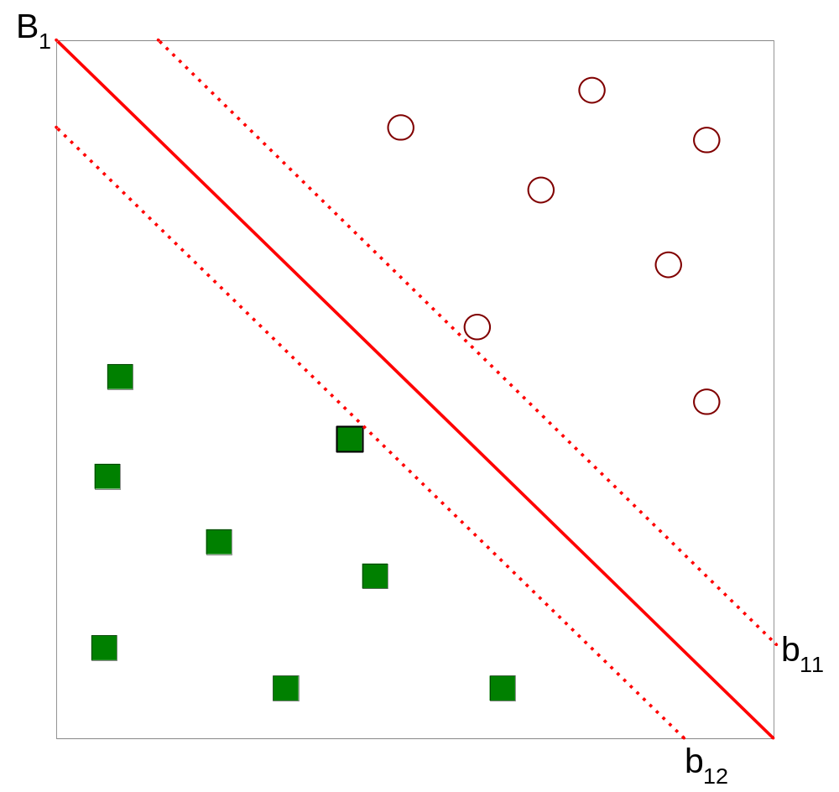



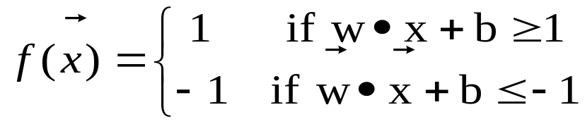
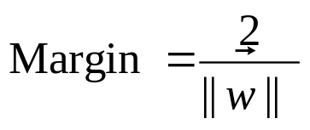
Support Vector Machines
二〇二六年十一月八日
Data Mining: Concepts and Techniques

Slide 30
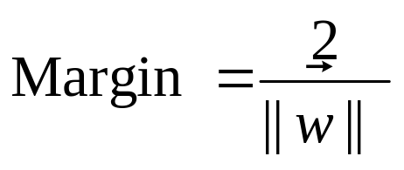
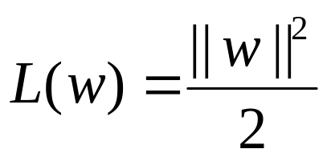
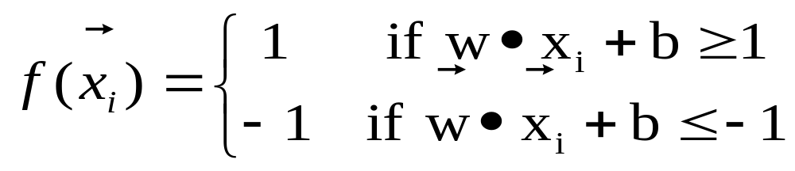
Support Vector Machines
We want to maximize:
  Which is equivalent to minimizing:
  But subjected to the following constraints:
    This is a constrained optimization problem
      Numerical approaches to solve it (e.g., quadratic programming)
二〇二六年十一月八日
Data Mining: Concepts and Techniques

Slide 31
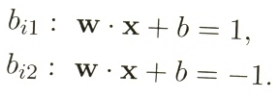



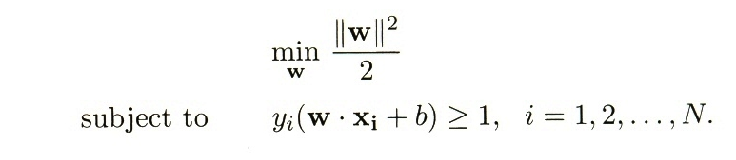
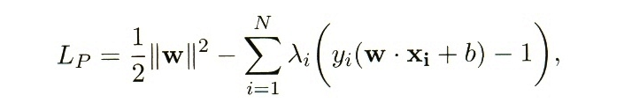
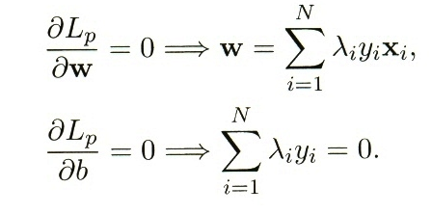
Lagrange for the optimization problem
Data Mining: Concepts and Techniques

Slide 32
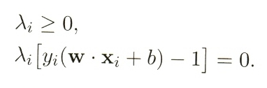
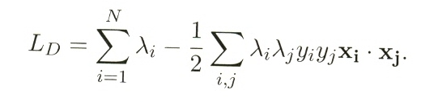
Transform to a set of equality constraints
Constraints on Lagrange multipliers ( λ_{i} ): Karush-Kuhn Tucker conditions
λ_{i} must be zero unless the training instances x_{i} satisfies the equation y_{i}(w‧x_{i}+b) = 1
λ_{i} > 0 : training instances lie along the hyperplanes are support vectors
Transform to a function of the Lagrange multipliers only
Solved by using numerical techniques (quadratic programming)
Data Mining: Concepts and Techniques

Slide 33
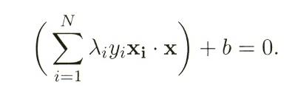
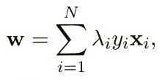

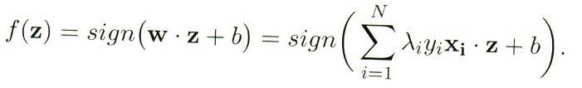
λ_{i} are found
The decision boundary
Data Mining: Concepts and Techniques

Slide 34
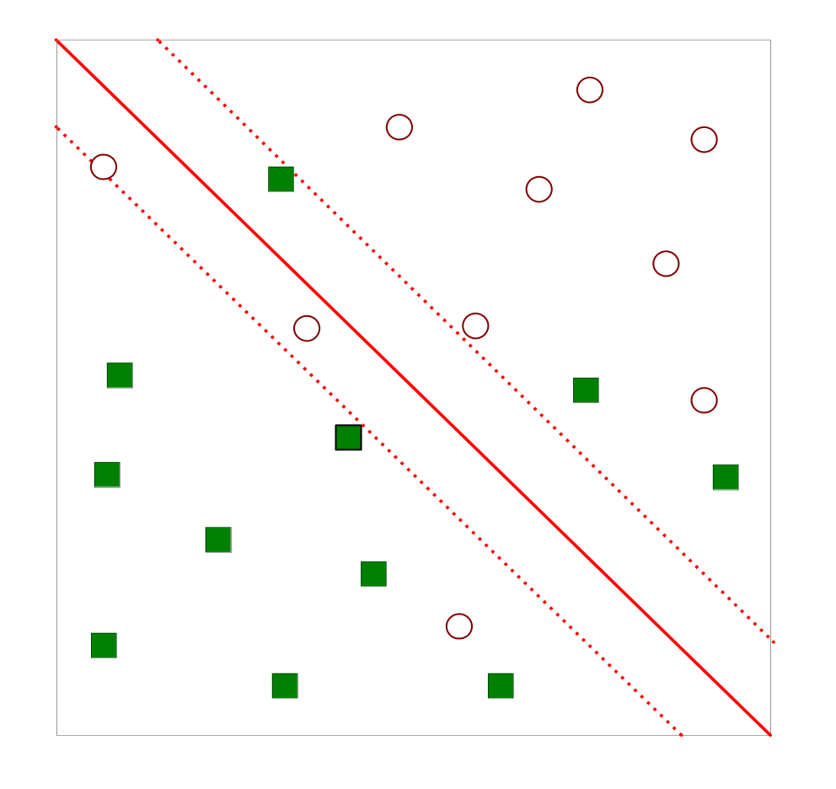
Support Vector Machines
What if the problem is not linearly separable?
二〇二六年十一月八日
Data Mining: Concepts and Techniques

Slide 35
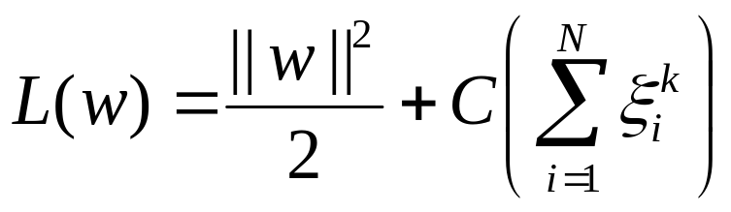
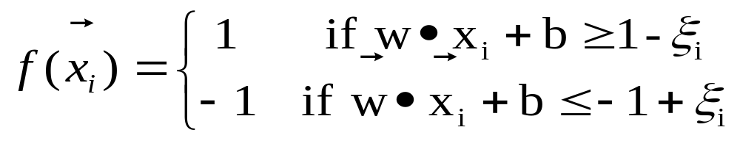
Support Vector Machines
What if the problem is not linearly separable?
  Introduce slack variables
    Need to minimize:
    Subject to:
二〇二六年十一月八日
Data Mining: Concepts and Techniques

Slide 36
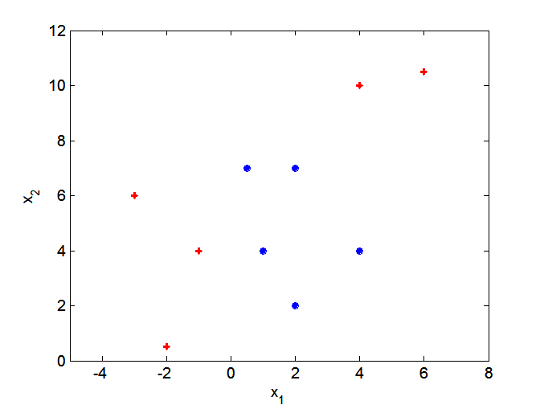
Nonlinear Support Vector Machines
What if decision boundary is not linear?
二〇二六年十一月八日
Data Mining: Concepts and Techniques

Slide 37
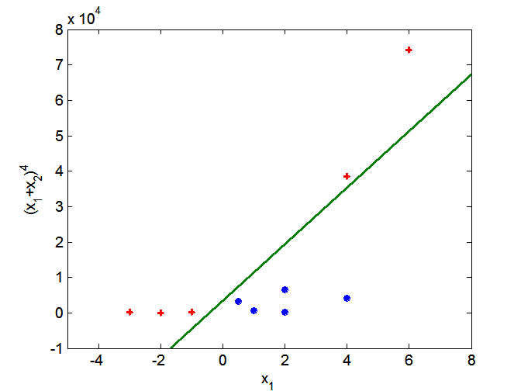
Nonlinear Support Vector Machines
Transform data into higher dimensional space
二〇二六年十一月八日
Data Mining: Concepts and Techniques

Slide 38
Why Is SVM Effective on High Dimensional Data?
The complexity of trained classifier is characterized by the # of support vectors rather than the dimensionality of the data
The support vectors are the essential or critical training examples —they lie closest to the decision boundary (MMH)
If all other training examples are removed and the training is repeated, the same separating hyperplane would be found
The number of support vectors found can be used to compute an (upper) bound on the expected error rate of the SVM classifier, which is independent of the data dimensionality
Thus, an SVM with a small number of support vectors can have good generalization, even when the dimensionality of the data is high

Slide 39


SVM—Linearly Inseparable
Transform the original input data into a higher dimensional space
Search for a linear separating hyperplane in the new space

Slide 40
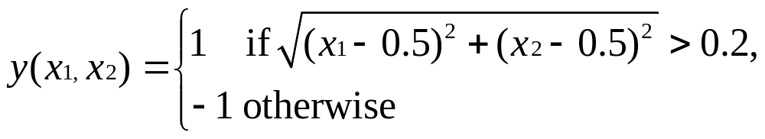
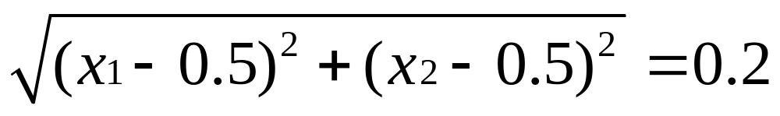
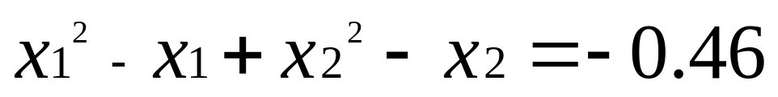
SVM

Slide 41
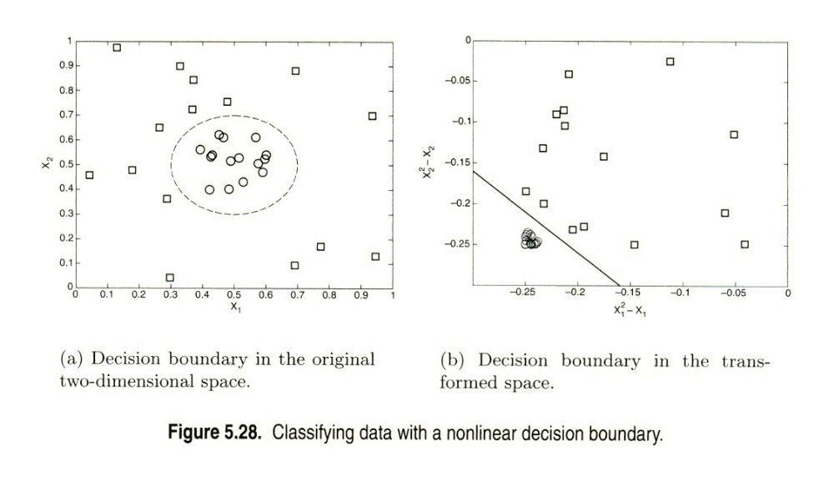

Slide 42
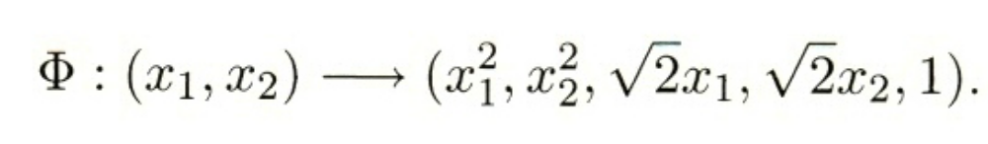
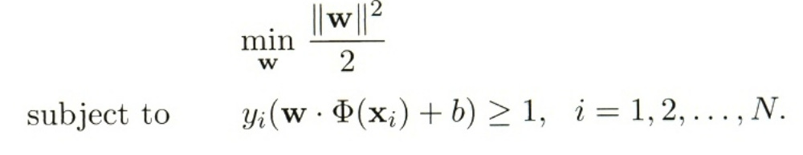

Slide 43
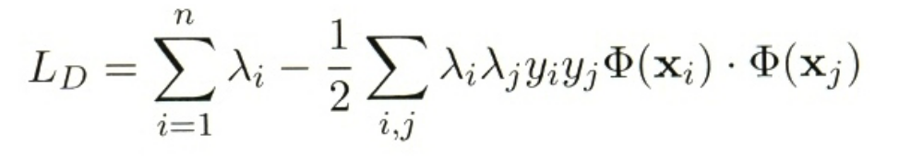
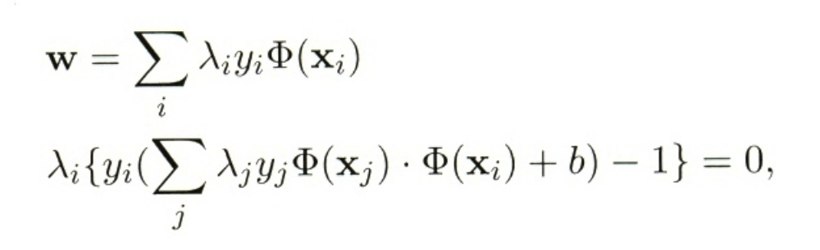
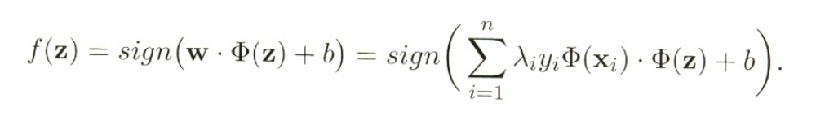

Slide 44
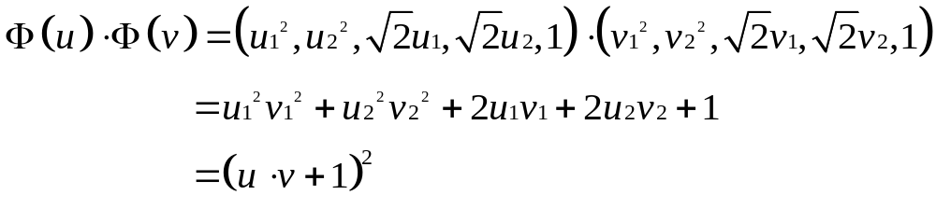
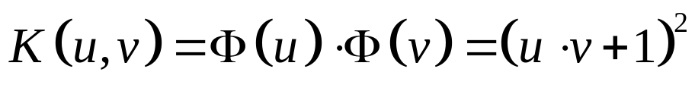
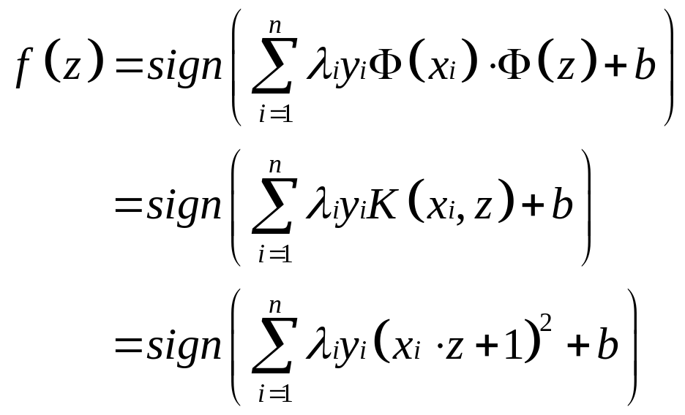

Slide 45
The similarity function, K, which is computed in the original attribute space, is known as the kernel function
the kernel functions used in nonlinear SVM must satisfy a mathematical principle known as Mercer’s theorem.
kernel functions can always be expressed as the dot product between two input vectors in some high-dimensional spaces.
The transformed space of the SVM kernels is called a reproducing kernel Hilbert space (RKHS).
computing the dot products using kernel functions is considerably cheaper than using the transformed attribute set.
since the computations are performed in the original space, issues associated with the curse of dimensionality problem can be avoided.
Data Mining: Concepts and Techniques

Slide 46
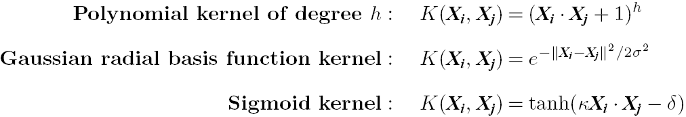
SVM: Different Kernel functions
Instead of computing the dot product on the transformed data, it is math. equivalent to applying a kernel function K(X_{i}, X_{j}) to the original data, i.e., K(X_{i}, X_{j}) = Φ(X_{i}) Φ(X_{j})
Typical Kernel Functions
SVM can also be used for classifying multiple (> 2) classes and for regression analysis (with additional parameters)

Slide 47
SVM Related Links
SVM Website: http://www.kernel-machines.org/
Representative implementations
  LIBSVM: an efficient implementation of SVM, multi-class classifications, nu-SVM, one-class SVM, including also various interfaces with java, python, etc.
  SVM-light: simpler but performance is not better than LIBSVM, support only binary classification and only in C
  SVM-torch: another recent implementation also written in C

Slide 48
Chapter 9. Classification: Advanced Methods
Bayesian Belief Networks
Classification by Backpropagation
Support Vector Machines
Classification by Using Frequent Patterns
Lazy Learners (or Learning from Your Neighbors)
Other Classification Methods
Additional Topics Regarding Classification
Summary

Slide 49
Associative Classification
Associative classification: Major steps
  Mine data to find strong associations between frequent patterns (conjunctions of attribute-value pairs) and class labels
  Association rules are generated in the form of
      P₁ ^ p₂ … ^ p_{l} → “A_{class} = C” (conf, sup)
  Organize the rules to form a rule-based classifier
Why effective?
  It explores highly confident associations among multiple attributes and may overcome some constraints introduced by decision-tree induction, which considers only one attribute at a time
  Associative classification has been found to be often more accurate than some traditional classification methods, such as C4.5

Slide 50
Chapter 9. Classification: Advanced Methods
Bayesian Belief Networks
Classification by Backpropagation
Support Vector Machines
Classification by Using Frequent Patterns
Lazy Learners (or Learning from Your Neighbors)
Other Classification Methods
Additional Topics Regarding Classification
Summary

Slide 51
Lazy vs. Eager Learning
Lazy vs. eager learning
  Lazy learning (e.g., instance-based learning): Simply stores training data (or only minor processing) and waits until it is given a test tuple
  Eager learning (the above discussed methods): Given a set of training tuples, constructs a classification model before receiving new (e.g., test) data to classify
Lazy: less time in training but more time in predicting
Accuracy
  Lazy method effectively uses a richer hypothesis space since it uses many local linear functions to form an implicit global approximation to the target function
  Eager: must commit to a single hypothesis that covers the entire instance space

Slide 52
Lazy Learner: Instance-Based Methods
Instance-based learning:
  Store training examples and delay the processing (“lazy evaluation”) until a new instance must be classified
Typical approaches
  k-nearest neighbor approach
    Instances represented as points in a Euclidean space.
  Locally weighted regression
    Constructs local approximation
  Case-based reasoning
    Uses symbolic representations and knowledge-based inference

Slide 53
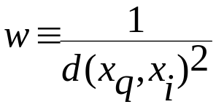
Discussion on the k-NN Algorithm
k-NN for real-valued prediction for a given unknown tuple
  Returns the mean values of the k nearest neighbors
Distance-weighted nearest neighbor algorithm
  Weight the contribution of each of the k neighbors according to their distance to the query x_{q}
    Give greater weight to closer neighbors
Robust to noisy data by averaging k-nearest neighbors
Curse of dimensionality: distance between neighbors could be dominated by irrelevant attributes
  To overcome it, axes stretch or elimination of the least relevant attributes

Slide 54
Case-Based Reasoning (CBR)
CBR: Uses a database of problem solutions to solve new problems
Store symbolic description (tuples or cases)—not points in a Euclidean space
Applications: Customer-service (product-related diagnosis), legal ruling
Methodology
  Instances represented by rich symbolic descriptions (e.g., function graphs)
  Search for similar cases, multiple retrieved cases may be combined
  Tight coupling between case retrieval, knowledge-based reasoning, and problem solving
Challenges
  Find a good similarity metric
  Indexing based on syntactic similarity measure, and when failure, backtracking, and adapting to additional cases

Slide 55
Chapter 9. Classification: Advanced Methods
Bayesian Belief Networks
Classification by Backpropagation
Support Vector Machines
Classification by Using Frequent Patterns
Lazy Learners (or Learning from Your Neighbors)
Other Classification Methods
Additional Topics Regarding Classification
Summary

Slide 56
Genetic Algorithms
p.335
GA is based on an analogy to biological processes.
GA apply the same idea to problems where the solution can be expressed as an “individual” and the problem is to maximize the “fitness” of individuals.
In the past few years, GA have been applied to three areas with promising results：
  Training neural networks
  Generating scoring functions for MBR
  As embedded optimization engines in scheduling packages

Slide 57
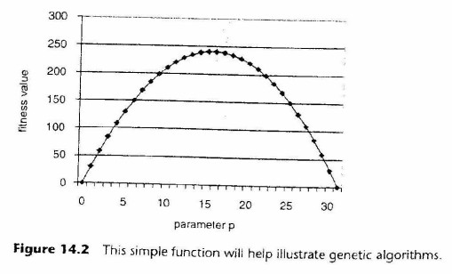
Genetics on Computers (1/11)
p.339
A simple example:
  A single parameter p in the range form 0 to 31
  The function for this purpose is 31p-p²
  The function peaks at the values 15 and 16, represented as 01111 and 10000 respectively.

Slide 58
Genetics on Computers (2/11)
p.339
For this example, the appropriate fitness function is 31p-p².
The technique consists of applying the following steps：
  Identify the genome and fitness functions, and create an initial generation of genomes.
  Modify the initial population by applying selection, crossover, and mutation.
  Repeat step 2 until the fitness of the population no longer improves.

Slide 59
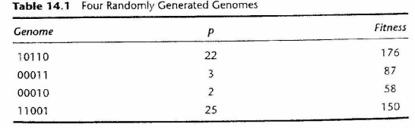
Genetics on Computers (3/11)
p.340
The first step in using genetic algorithms is setting up the problem.
average fitness is 117.75

Slide 60
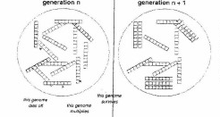
Genetics on Computers (4/11)
p.341
Selection：
  Keeps the size of the population constant but increases the fitness of the next generation.

Slide 61

Genetics on Computers (5/11)
p.342
roulette wheel or spinner approach selection
A spinner is set up with each genome having an area proportional to its fitness.
It is spun randomly, landing at a spot pointing to a particular genome.

Slide 62


Genetics on Computers (6/11)
p.342
Average fitness 140

Slide 63

Genetics on Computers (7/11)
p.341
Crossover：
  is a way of combining two genomes.
  A crossover position determines where the genomes “break” and are recombined.

Slide 64


Genetics on Computers (8/11)
p.343
Crossover, creates two new genomes from two existing ones by gluing together pieces of each genome.
For instance, starting with the two genomes 10110 and 00010 and using a crossover position between the second and third position works as follows:

Slide 65

Genetics on Computers (9/11)
p.344
The resulting genomes, called children, have a piece inherited from each of their parents.
Crossover probability
Average fitness 178.5

Slide 66

Genetics on Computers (10/11)
p.341
Mutation：
  Makes an occasional random change to a random position in a genome.
  This allows features to appear that may not have been in the original population.

Slide 67

Genetics on Computers (11/11)
p.344
Assume that there is one mutation in this generation, occurring in the second genome at position 3.
  11001－＞ 11101
150－＞58

Slide 68
Genetic Algorithms (GA)
Genetic Algorithm: based on an analogy to biological evolution
An initial population is created consisting of randomly generated rules
  Each rule is represented by a string of bits
  E.g., if A₁ and ¬A₂ then C₂ can be encoded as 100
  If an attribute has k > 2 values, k bits can be used
Based on the notion of survival of the fittest, a new population is formed to consist of the fittest rules and their offspring
The fitness of a rule is represented by its classification accuracy on a set of training examples
Offspring are generated by crossover and mutation
The process continues until a population P evolves when each rule in P satisfies a prespecified threshold
Slow but easily parallelizable

Slide 69

Fuzzy Set Approaches
Fuzzy logic uses truth values between 0.0 and 1.0 to represent the degree of membership (such as in a fuzzy membership graph)
Attribute values are converted to fuzzy values. Ex.:
  Income, x, is assigned a fuzzy membership value to each of the discrete categories {low, medium, high}, e.g. $49K belongs to “medium income” with fuzzy value 0.15 but belongs to “high income” with fuzzy value 0.96
  Fuzzy membership values do not have to sum to 1.
Each applicable rule contributes a vote for membership in the categories
Typically, the truth values for each predicted category are summed, and these sums are combined

Slide 70
Chapter 9. Classification: Advanced Methods
Bayesian Belief Networks
Classification by Backpropagation
Support Vector Machines
Classification by Using Frequent Patterns
Lazy Learners (or Learning from Your Neighbors)
Other Classification Methods
Additional Topics Regarding Classification
Summary

Slide 71
Multiclass Classification
Classification involving more than two classes (i.e., > 2 Classes)
Method 1. One-vs.-all (OVA): Learn a classifier one at a time
  Given m classes, train m classifiers: one for each class
  Classifier j: treat tuples in class j as positive & all others as negative
  To classify a tuple X, the set of classifiers vote as an ensemble
Method 2. All-vs.-all (AVA): Learn a classifier for each pair of classes
  Given m classes, construct m(m-1)/2 binary classifiers
  A classifier is trained using tuples of the two classes
  To classify a tuple X, each classifier votes. X is assigned to the class with maximal vote
Comparison
  All-vs.-all tends to be superior to one-vs.-all
  Problem: Binary classifier is sensitive to errors, and errors affect vote count

Slide 72
Semi-Supervised Classification
Semi-supervised: Uses labeled and unlabeled data to build a classifier
Self-training:
  Build a classifier using the labeled data
  Use it to label the unlabeled data, and those with the most confident label prediction are added to the set of labeled data
  Repeat the above process
  Adv: easy to understand; disadv: may reinforce errors
Co-training: Use two or more classifiers to teach each other
  Each learner uses a mutually independent set of features of each tuple to train a good classifier, say f₁
  Then f₁ and f₂ are used to predict the class label for unlabeled data X
  Teach each other: The tuple having the most confident prediction from f₁ is added to the set of labeled data for f₂, & vice versa
Other methods, e.g., joint probability distribution of features and labels

Slide 73
Chapter 9. Classification: Advanced Methods
Bayesian Belief Networks
Classification by Backpropagation
Support Vector Machines
Classification by Using Frequent Patterns
Lazy Learners (or Learning from Your Neighbors)
Other Classification Methods
Additional Topics Regarding Classification
Numerical Prediction

Slide 74
What Is Prediction?
(Numerical) prediction is similar to classification
  construct a model
  use model to predict continuous or ordered value for a given input
Prediction is different from classification
  Classification refers to predict categorical class label
  Prediction models continuous-valued functions
Major method for prediction: regression
  model the relationship between one or more independent or predictor variables and a dependent or response variable
Regression analysis
  Linear and multiple regression
  Non-linear regression
  Other regression methods: generalized linear model, Poisson regression, log-linear models, regression trees

Slide 75


Linear Regression
Linear regression: involves a response variable y and a single predictor variable x
    y = w₀ + w₁ x
  where w₀ (y-intercept) and w₁ (slope) are regression coefficients
Method of least squares: estimates the best-fitting straight line
Multiple linear regression: involves more than one predictor variable
  Training data is of the form (X₁, y₁), (X₂, y₂),…, (X_{|D|}, y_{|D|})
  Ex. For 2-D data, we may have: y = w₀ + w₁ x₁+ w₂ x₂
  Solvable by extension of least square method or using SAS, S-Plus
  Many nonlinear functions can be transformed into the above

Slide 76
Nonlinear Regression
Some nonlinear models can be modeled by a polynomial function
A polynomial regression model can be transformed into linear regression model. For example,
    y = w₀ + w₁ x + w₂ x² + w₃ x³
  convertible to linear with new variables: x₂ = x², x₃= x³
    y = w₀ + w₁ x + w₂ x₂ + w₃ x₃
Other functions, such as power function, can also be transformed to linear model
Some models are intractable nonlinear (e.g., sum of exponential terms)
  possible to obtain least square estimates through extensive calculation on more complex formulae

Slide 77
Other Regression-Based Models
Generalized linear model:
  Foundation on which linear regression can be applied to modeling categorical response variables
  Variance of y is a function of the mean value of y, not a constant
  Logistic regression: models the prob. of some event occurring as a linear function of a set of predictor variables
  Poisson regression: models the data that exhibit a Poisson distribution
Log-linear models: (for categorical data)
  Approximate discrete multidimensional prob. distributions
  Also useful for data compression and smoothing
Regression trees and model trees
  Trees to predict continuous values rather than class labels

Slide 78
Regression Trees and Model Trees
Regression tree: proposed in CART system (Breiman et al. 1984)
  CART: Classification And Regression Trees
  Each leaf stores a continuous-valued prediction
  It is the average value of the predicted attribute for the training tuples that reach the leaf
Model tree: proposed by Quinlan (1992)
  Each leaf holds a regression model—a multivariate linear equation for the predicted attribute
  A more general case than regression tree
Regression and model trees tend to be more accurate than linear regression when the data are not represented well by a simple linear model

